Slide 1
Linux device driver
Day 7 PPT
-SUBITHRA s

Slide 2
Data structure
A data structure is a way of organizing, storing, and managing data effectively so that it can be accessed and manipulated efficiently. There are various types of data structures, each with its own advantages and applications. Here are some common types of data structures:
Arrays: Arrays are a collection of elements stored in contiguous memory locations. Elements are accessed using an index. Arrays have a fixed size and offer constant-time access to elements, but inserting or deleting elements may require shifting elements, resulting in inefficient operations.
Linked Lists: Linked lists consist of nodes where each node contains data and a reference (pointer) to the next node in the sequence. Linked lists can be singly linked (each node points to the next node) or doubly linked (each node points to both the next and previous nodes). Linked lists allow efficient insertion and deletion of elements anywhere in the list, but accessing elements requires traversing the list from the beginning.

Slide 3
Stacks: stacks are a last-in-first-out (LIFO) data structure where elements are inserted and removed from the same end, known as the top. Stack operations include push (inserting an element onto the top of the stack) and pop (removing the top element). Stacks are commonly used for function call management, expression evaluation, and backtracking algorithms.
Queues: queues are a first-in-first-out (fifo) data structure where elements are inserted at the rear (enqueue) and removed from the front (dequeue). Queues support operations such as enqueue (inserting an element into the queue) and dequeue (removing an element from the queue). Queues are used in scheduling, breadth-first search, and buffering.

Slide 4
Trees: trees are hierarchical data structures composed of nodes where each node has a value and references (pointers) to child nodes. Trees consist of a root node, internal nodes, and leaf nodes. Common types of trees include binary trees (each node has at most two children), binary search trees (a binary tree with a specific ordering property), and balanced trees (maintain a balanced structure to ensure efficient operations).
Graphs: graphs are collections of nodes (vertices) connected by edges. Graphs can be directed (edges have a direction) or undirected (edges have no direction). Graphs can be represented using adjacency matrices or adjacency lists. Graphs are used in network routing, social networks, and shortest path algorithms.
Hash tables: hash tables are data structures that store key-value pairs. They use a hash function to map keys to indices in an array, allowing efficient insertion, deletion, and retrieval of elements. Hash tables offer constant-time average-case performance for these operations, making them useful for implementing dictionaries, caches, and database indexing.

Slide 5
ARRAYS
Arrays are a fundamental data structure in programming that store collections of elements of the same type. They provide a convenient way to access and manipulate data. Depending on their characteristics, arrays can be categorized into several types:
One-dimensional arrays:
Also known as single-dimensional arrays, these arrays store elements in a linear sequence. Each element is accessed using a single index. One-dimensional arrays are the simplest form of arrays and are widely used in programming.
Example: int numbers[5];
Multi-dimensional arrays:
Multi-dimensional arrays store elements in multiple dimensions, forming a grid-like structure. They are often used to represent matrices or tables.
Common types include:
Two-dimensional arrays: these arrays have rows and columns and are often used to represent matrices.
Example: int matrix[3][3];
Three-dimensional arrays: these arrays add depth to the grid structure and are used in applications such as representing 3D grids or volumes.
Example: int cube[3][3][3];

Slide 6
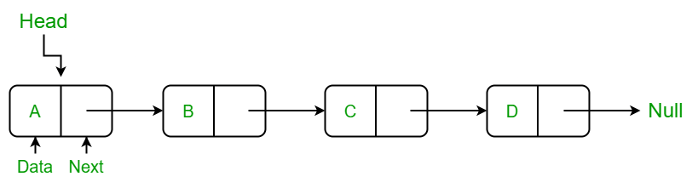
Linked list
Linked lists are a type of data structure that consists of a sequence of elements, called nodes, where each node contains both data and a reference (or pointer) to the next node in the sequence. Linked lists offer dynamic memory allocation, efficient insertion and deletion operations, and can vary in structure and behavior based on how nodes are linked together. Here are the types of linked lists:
Singly linked list:
In a singly linked list, each node contains a data element and a pointer/reference to the next node in the sequence. The last node typically points to a null reference to indicate the end of the list.

Slide 7
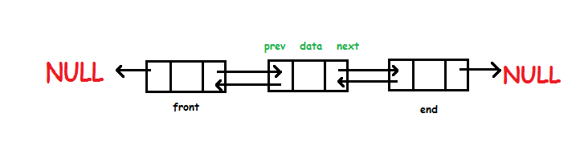
Doubly linked list:
A node in a singly linked list only has one pointer which points to the next node in the linked list. A node in a doubly linked list on the other hand has two pointers, one pointing to the next node and the other pointing to the previous node.This allows you to traverse the linked list in both directions. The head in a doubly linked list will point to both null and the next node. The tail in a doubly linked list will point to null and the previous node.

Slide 8
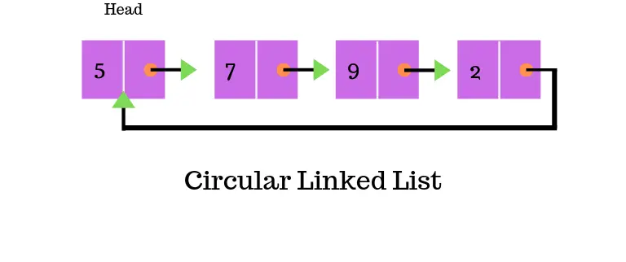
Circular linked list
A circular linked list never ends, just like if you were to follow the line of a circle… it just keeps wrapping back onto itself. This type of linked list is simply a singly linked list where the tail, instead of pointing to null points back to the head node.

Slide 9
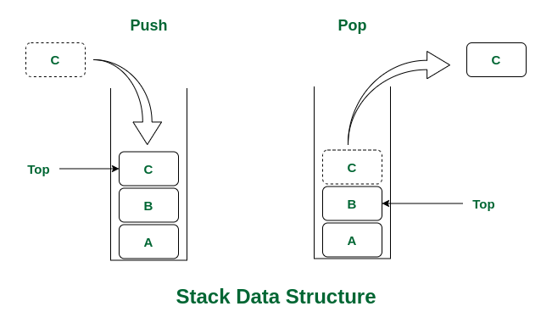
Stack
A stack is a linear data structure that follows the Last In, First Out (LIFO) principle, meaning that the last element added to the stack is the first one to be removed. It can be visualized as a stack of plates where you can only add or remove plates from the top.
A stack typically supports the following operations:
Push: Adds an element to the top of the stack.
Pop: Removes and returns the top element of the stack.
Peek/Top: Returns the top element of the stack without removing it.
isEmpty: Checks if the stack is empty.
isFull: Checks if the stack is full (for fixed-size stacks).

Slide 10
Array-based stack: A fixed-size array is used to store the elements of the stack. A variable, usually called top, is used to keep track of the index of the top element of the stack. Push operation increments top and inserts the element at top index. Pop operation returns the element at top index and decrements top. Array-based stacks have a fixed capacity determined at the time of creation, and they may overflow if the capacity is exceeded. Linked list-based stack: A linked list is used to store the elements of the stack. Each node of the linked list contains the data and a reference to the next node. The top of the stack is represented by the head of the linked list. Push operation adds a new node to the head of the linked list. Pop operation removes and returns the node at the head of the linked list. Linked list-based stacks can dynamically grow and shrink as needed, but they require extra memory for storing the pointers.

Slide 11
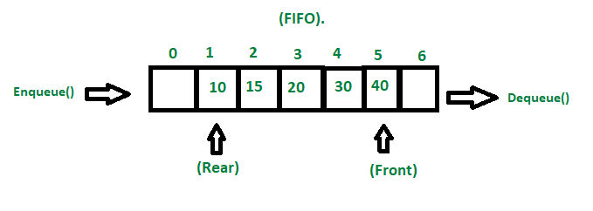
QUEUE
A queue is a linear data structure that follows the first in, first out (FIFO) principle, meaning that the element that is added first is the one that gets removed first. It can be visualized as a line of people waiting for service, where the person who arrived first gets served first.
A queue typically supports the following operations:
Enqueue: adds an element to the rear (end) of the queue.
Dequeue: removes and returns the element at the front (head) of the queue.
Front: returns the element at the front of the queue without removing it.
Isempty: checks if the queue is empty.
Isfull: checks if the queue is full (for fixed-size queues).

Slide 12
Array-based queue:
In this implementation, a fixed-size array is used to store the elements of the queue. Two variables, usually called front and rear, are used to keep track of the indices of the front and rear elements of the queue, respectively.
Enqueue operation inserts an element at the rear index and increments rear.
Dequeue operation removes and returns the element at the front index and increments front.
Array-based queues may encounter overflow if the capacity is exceeded, but they have constant-time access for enqueue and dequeue operations.
Linked list-based queue:
In this implementation, a linked list is used to store the elements of the queue. Each node of the linked list contains the data and a reference to the next node.
The front and rear of the queue are represented by the head and tail of the linked list, respectively.
Enqueue operation adds a new node to the tail of the linked list.
Dequeue operation removes and returns the node at the head of the linked list.
Linked list-based queues can dynamically grow and shrink as needed, but they require extra memory for storing the pointers.

Slide 13
THANK YOU

